Slide 1


Slide 2

The future won’t be powered by energy alone—but by intelligence guiding every watt we use.
Project Journey:
AI-Driven Energy Consumption Prediction
Harnessing data for a smarter, sustainable future with our dedicated team.
Presented by:
Smarth Kaushal
Aniiket Gupta
Aadar Mishra

Slide 3


The Spark
Energy Waste Examples
Empty skyscrapers lit unnecessarily
Industries overloading power grids
Families unaware of high usage
Inspiration
Can we make cities smarter by predicting energy use?
Vision
Combine machine learning and sustainability to reduce waste.
Goal
Move beyond textbooks to real-world impact.

Slide 4


Understanding the
Problem
Core Issue
Not energy generation, but inefficient consumption.
We aimed to forecast, optimize, and educate.

Slide 5

Our Goals
Predict energy demand accurately using ML
Reduce waste and emissions
Help users control energy usage
Integrate renewable sources
Deliver insights via interactive dashboard

Slide 6

Data Collection and Exploration
Data Sources
Process
15 months hourly data from NITI Aayog ICED and Visual Crossing
Merged, cleaned, and explored datasets
Insights
Found strong seasonal and hourly trends early on

Slide 7
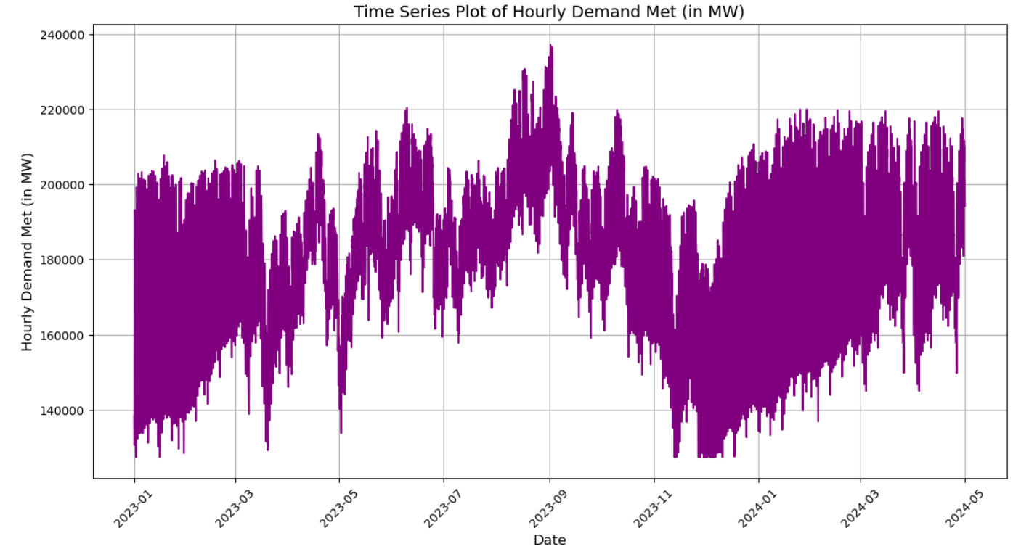
Feature Engineering
Time Features
Lag Features
Weather Indicators
Hour, day, month, season
Last hour, 7-day rolling mean
Temperature, humidity, solar radiation
Transforming raw data was crucial for model success.

Slide 8
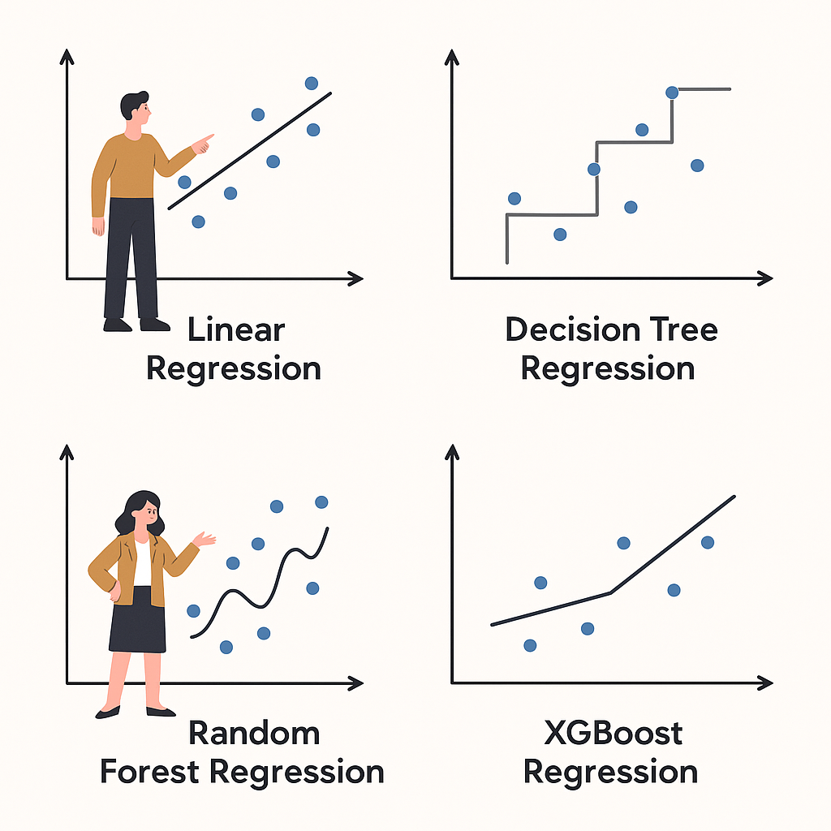
Model Experiments
Models Tested
Data Split
Linear Regression (baseline)
70% training, 15% validation, 15% test
Decision Tree
XGBoost (winner)
PyCaret AutoML (comparison)
Metrics
Tracked MAE, RMSE, and R² scores

Slide 9
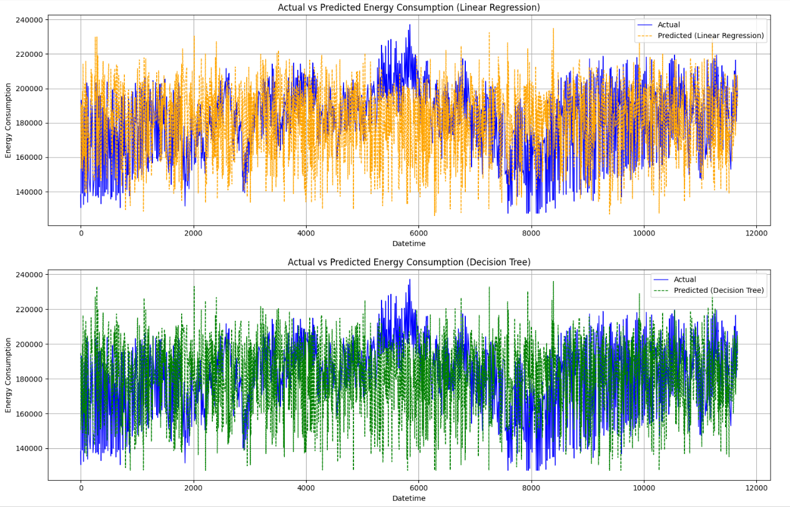
Model Training: Linear Regression & Decision Tree
Linear Regression
Models linear relationships; achieved MAE 2789.26,
RMSE 3668.53, R² 0.9664.
Decision Tree Regression
Captures non-linear patterns; achieved MAE 2286.59,
RMSE 3329.77, R² 0.9723.
Decision Trees offer interpretability and handle non-linearity but risk overfitting, mitigated by pruning and ensembles.

Slide 10
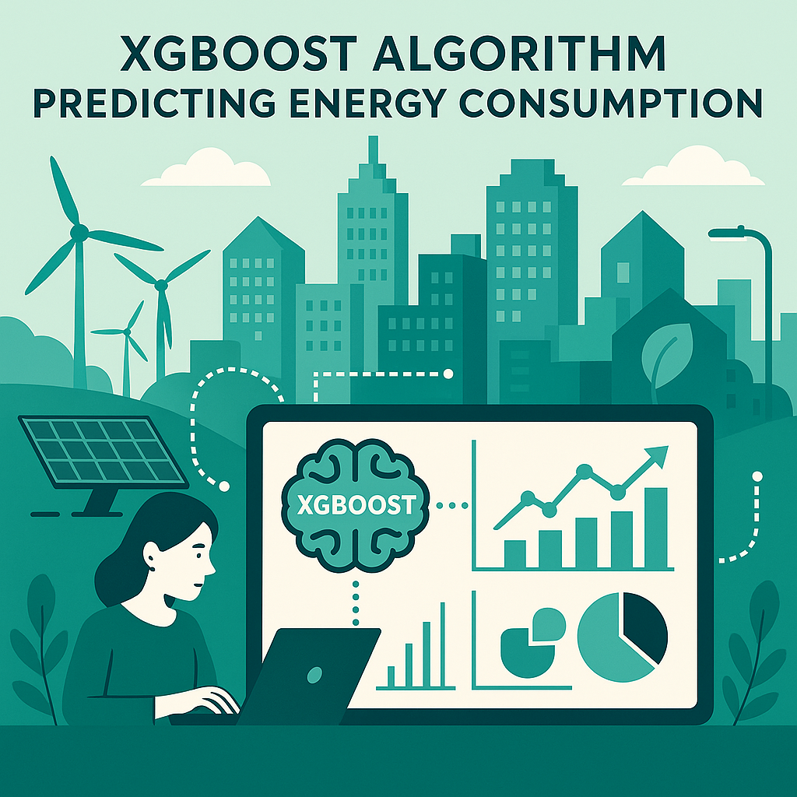
Advanced Modeling: XGBoost and Comparison
For XGBoost, the dataset was split into 70% training, 15% validation and 15% test data.
XGBoost Highlights
Handles missing data, uses ensemble of trees, regularization prevents overfitting, and is computationally efficient.
Performance Comparison
Manual XGBoost outperforms PyCaret's model with MAE 2125.12 vs 3431.21 and RMSE 2815.29 vs 4406.63.
Conclusion
Manual tuning and feature engineering yield superior accuracy, balancing automation speed with craftsmanship.

Slide 11

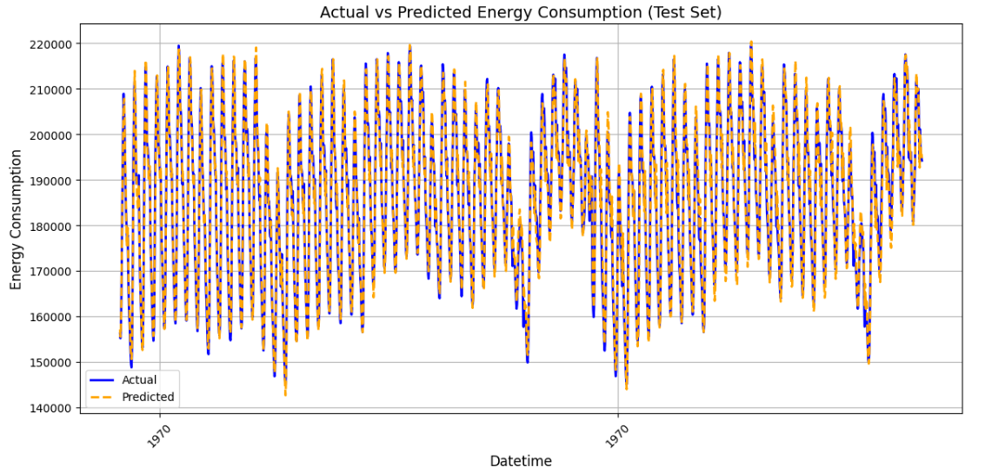
Winning Model: XGBoost
Performance
Why It Worked
MAE: 2119.81
Handles complex patterns
RMSE: 2815.23
Uses lag and rolling features well
R²: 0.97
Custom tuning beats automated methods

Slide 12
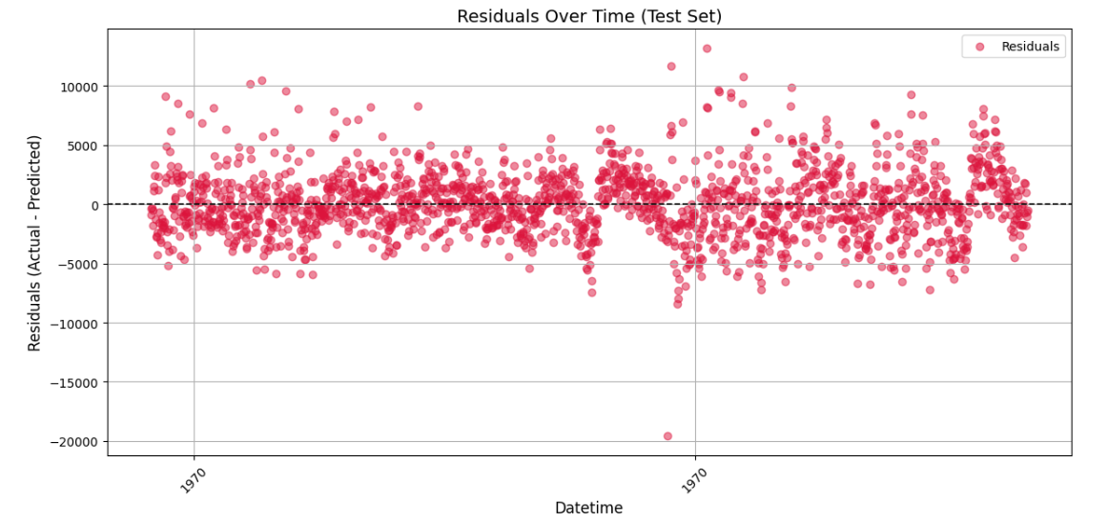

Slide 13
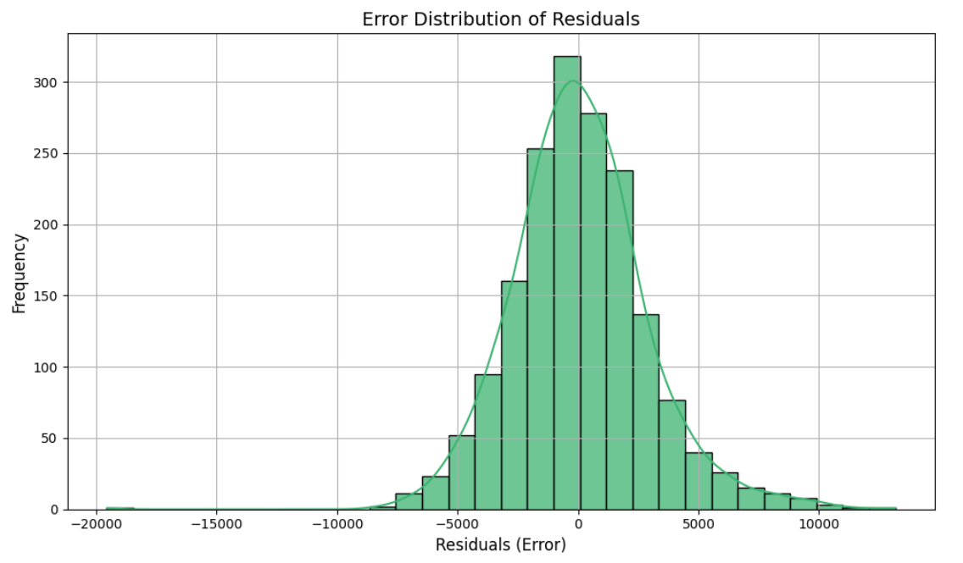

Slide 14
Final Results and Vision
Model Selection
XGBoost chosen for its robust performance and efficiency in energy forecasting.
Impact
Enables smart cities with automated energy optimization, reducing carbon emissions.
Future Enhancements
Plans include deep learning models and expanded research for greater accuracy and insights.

Slide 15
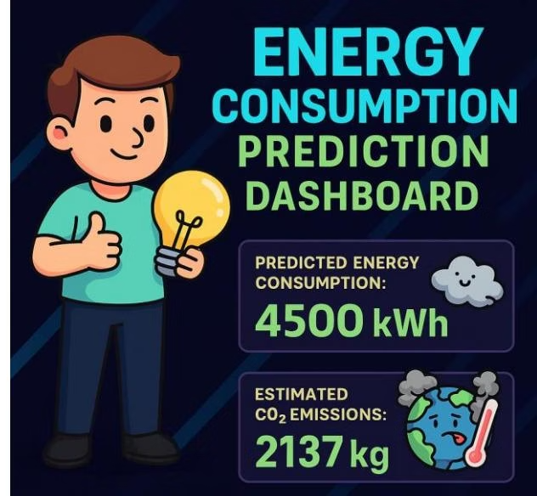

Dashboard Development & Project Journey
Dashboard Features
Our Journey
Real-time prediction, CSV upload, manual input, carbon footprint calculator, and actionable energy-saving suggestions.
From research challenges to teamwork and breakthroughs, this project was a learning and growth experience fueled by passion.
Explore the code on GitHub and experience the dashboard online to witness AI's role in smarter, sustainable energy management.

Slide 16


Slide 17
With lines of code and sparks of thought,
we crafted a model not just to predict—but to protect.
That’s all about our journey.
THANK YOU

